Slide 1
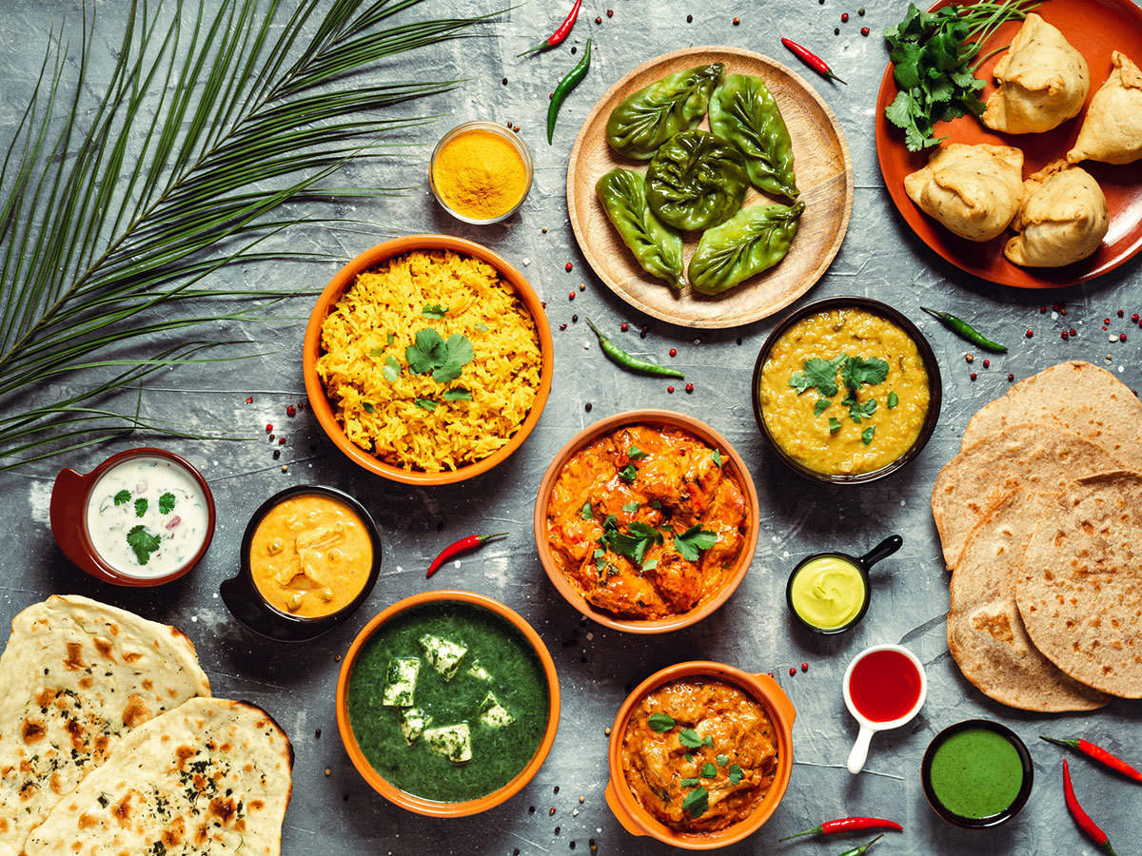



Indian Food Image Classification
Arti Ganjale
PGA 45
Capstone Project - II

Slide 2

Table of Contents
Sr. No | Content | Slide No.
1. | Introduction | 3
2. | Objective | 4
3 | Data Gathering | 5
4 | Data Preprocessing – I | 6-8
5 | Column Description | 9
6 | Data Preprocessing – II | 10
7 | Data Preprocessing – III | 11-15
8 | Data Preprocessing – IV | 16
9 | Data Preprocessing – V & VI | 17
10 | Random Sampling | 18
11 | Basic Model Building & Evaluation | 19
12 | Feature Selection | 20-21
13 | Final Model Building & Pickling | 22
14 | Demo Prediction | 23
15 | Future Scope | 24
16 | Conclusion | 25

Slide 3
Introduction
we will classify the Indian food images. India is known for its multi-culturalism. This multi-culturalism also influences Indian food. We have lots of variety in our Indian food. Food varies inter-state and intra-state across India. We will apply deep learning algorithms to identify these food items.
Notes:
According to Food and Agriculture Organization

Slide 4
Objective
The main objective of our food classification project is to develop a precise system using deep learning and CNNs to categorize different types of food accurately. This aims to enhance consumer experiences and support the food industry in delivering high-quality products.

Slide 5
Data Collection
Data was collected from Kaggle website.
Originally, this dataset consists of about 20K RGB images of food which is categorized into
20 different classes.
From this huge dataset, I have collected only 4k images of for model building purpose.
Details of images are as follows,

Slide 6
Data Collection
Class Name | Number of images
burger | 233
butter_naan | 217
chai | 247
chapati | 230
chole_bhature | 261
dal_makhani | 203
dhokla | 167
fried_rice | 250
idli | 207
jalebi | 193

Slide 7
Data Collection
Class Name | Number of images
kaathi_rolls | 191
kadai_paneer | 228
kulfi | 134
masala_dosa | 187
momos | 225
paani_puri | 85
pakode | 179
pav_bhaji | 210
pizza | 184
samosa | 164

Slide 8
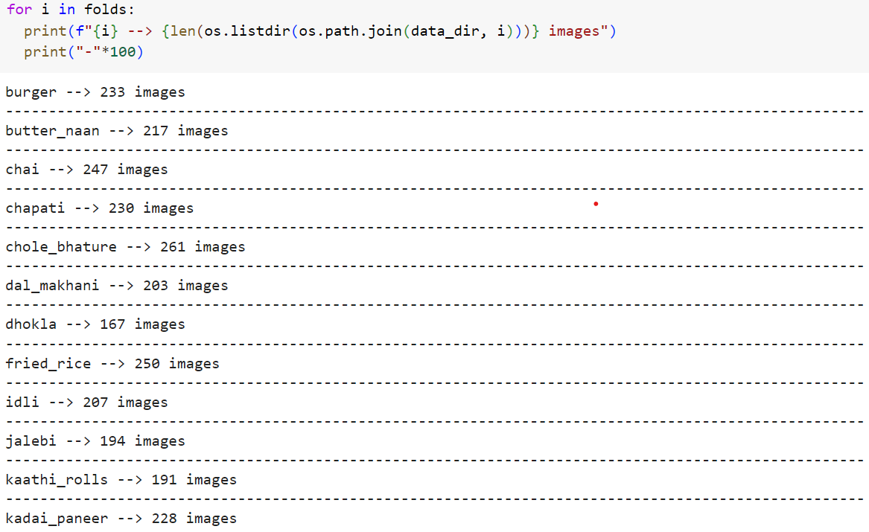
Dataset Overview - I
Representation of each category in dataset is as follows,

Slide 9
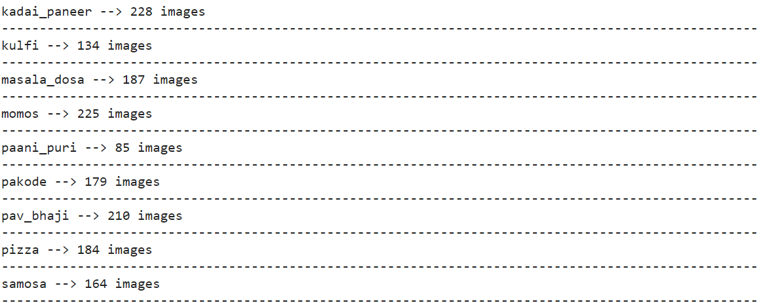
Dataset Overview - I
Representation of each category in dataset is as follows,

Slide 10
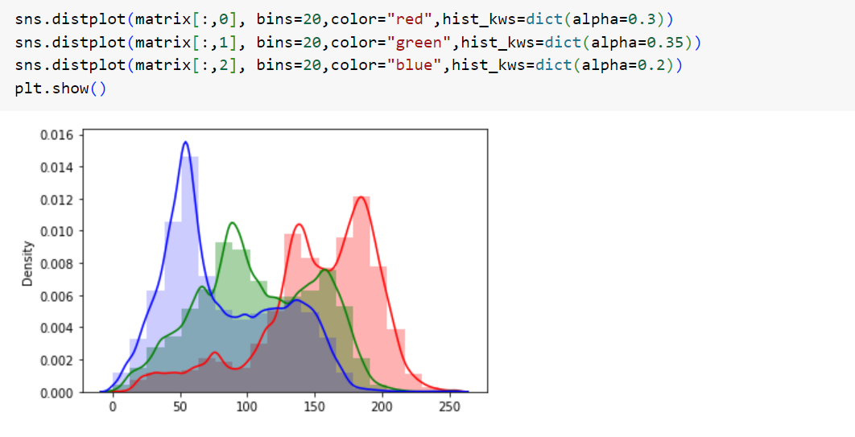
Dataset Overview - II
Representation of each category in dataset is as follows,

Slide 11
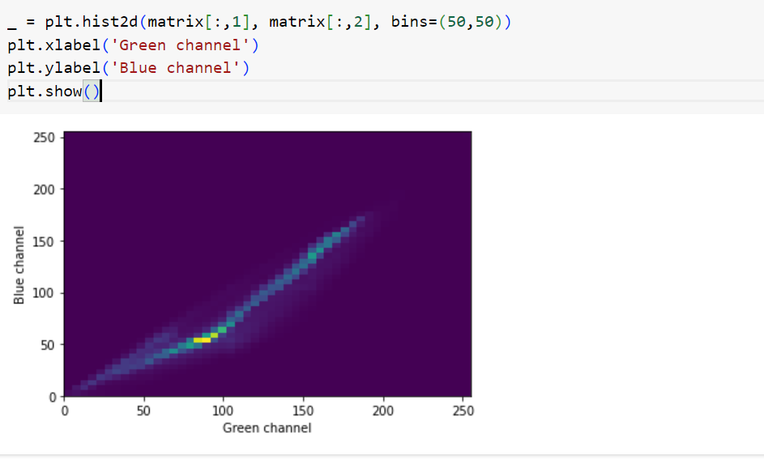
Dataset Overview - II

Slide 12
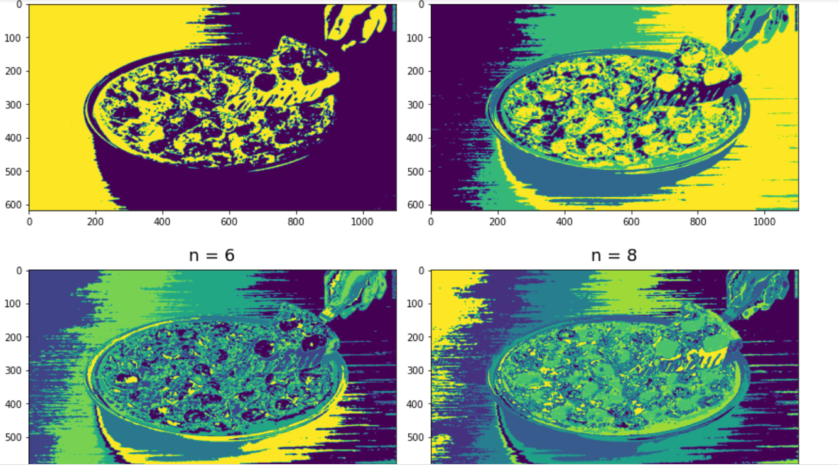
Dataset Overview - III

Slide 13
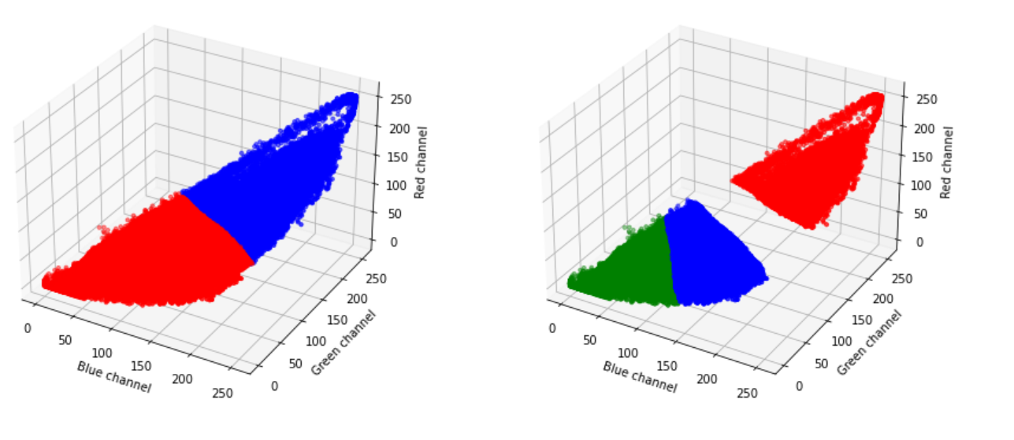
Dataset Overview - III

Slide 14
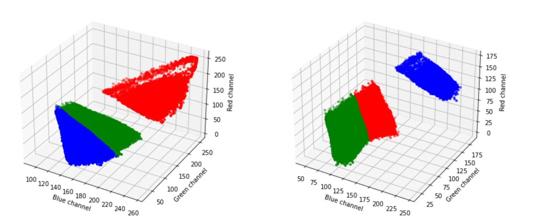
Dataset Overview - IV

Slide 15
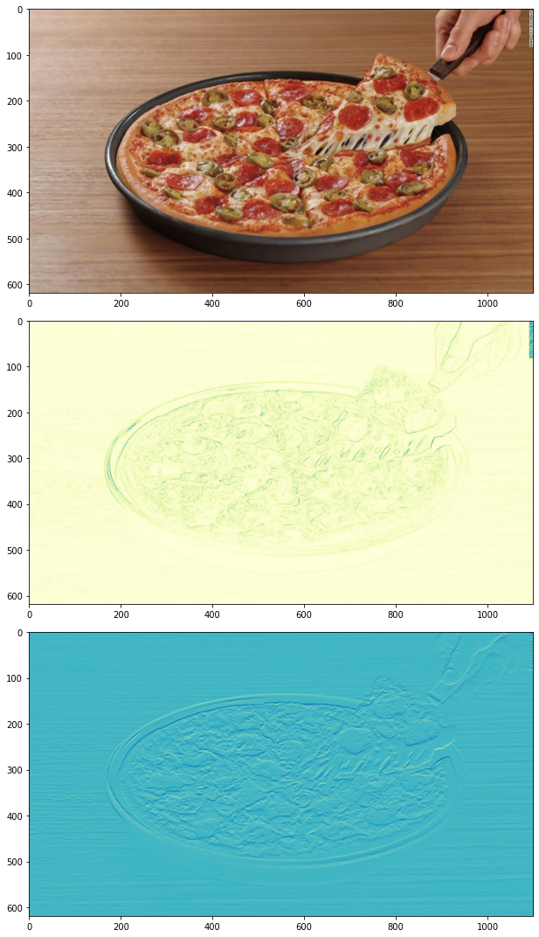
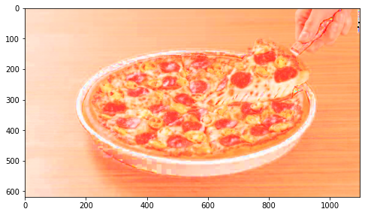
Dataset Overview - IV
Brightness normalization is a process that changes the range of pixel intensity values. Applications include photographs with poor contrast due to glare, for example. Normalization is sometimes called contrast stretching or histogram stretching.
Sobel filter is a basic way to get an edge magnitude/gradient image.

Slide 16
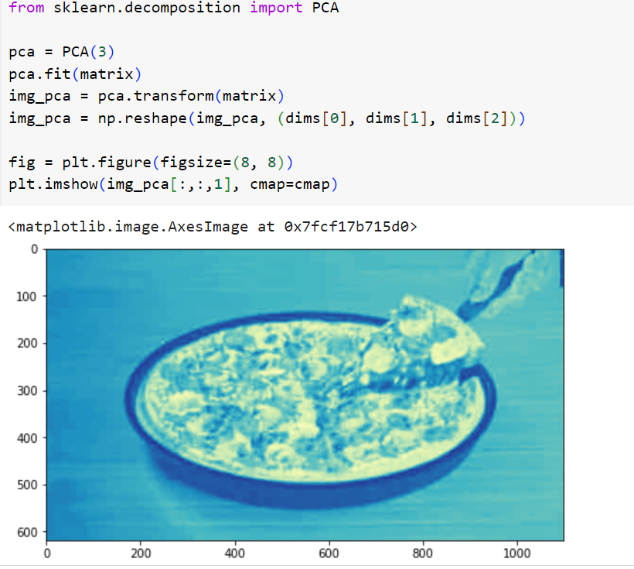
Dataset Overview - IV

Slide 17
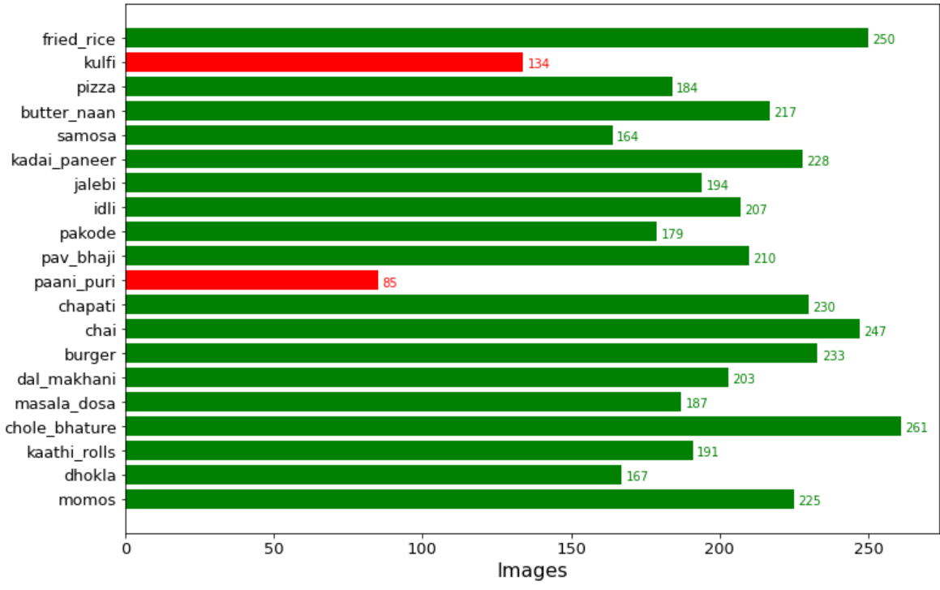
Exploratory Data Analysis (EDA)- IV

Slide 18
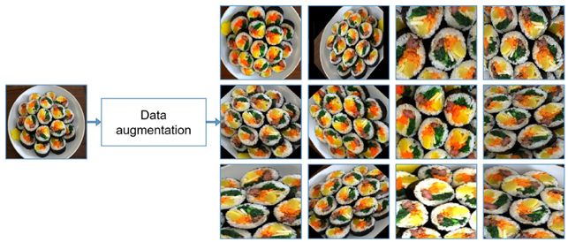
Image Preprocessing- IV
Data augmentation is a technique commonly used in training Convolutional Neural Networks (CNNs) to increase the diversity of training data without collecting new data samples. This technique helps prevent overfitting and improves the generalization ability of the model by generating new training samples through various transformations applied to the existing data.
Here are some common data augmentation techniques used in CNN training:
Image Rotation
Image Flipping
Image Scaling
Image Translation
Brightness Adjustment
Contrast Adjustment
Noise Injection
Random Cropping
Color Jittering
Shearing

Slide 19
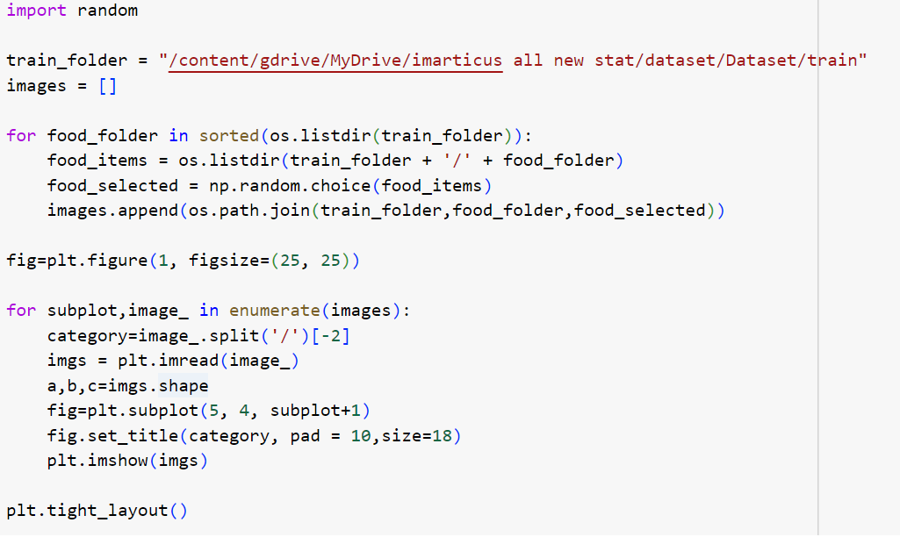
Image Preprocessing-I

Slide 20
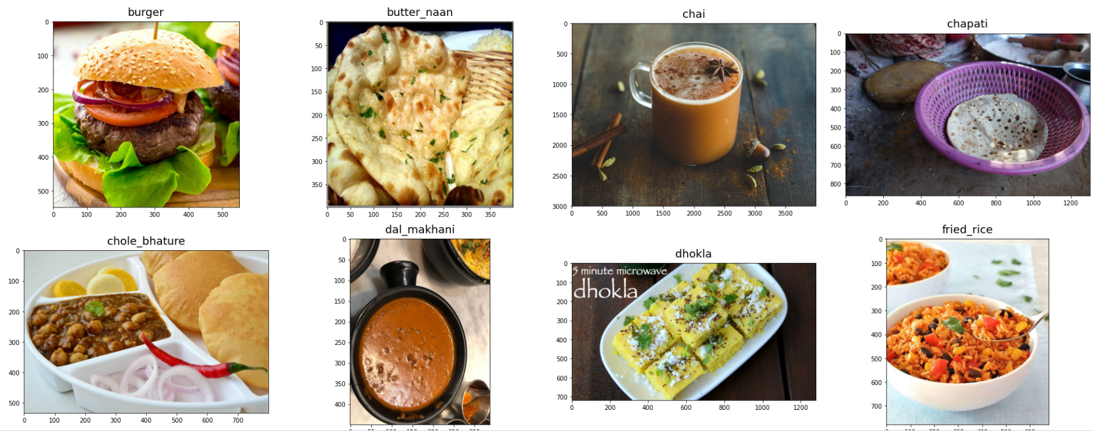
Image Preprocessing-I

Slide 21
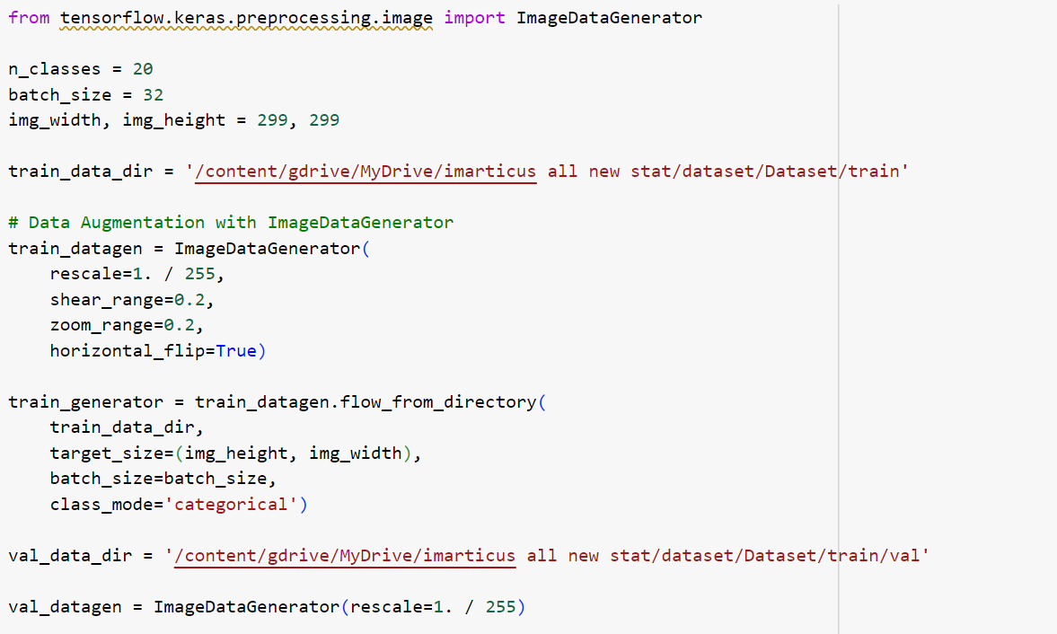
Random Sampling

Slide 22
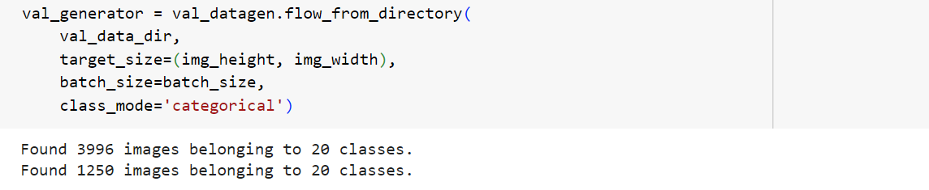
Image Preprocessing-II

Slide 23
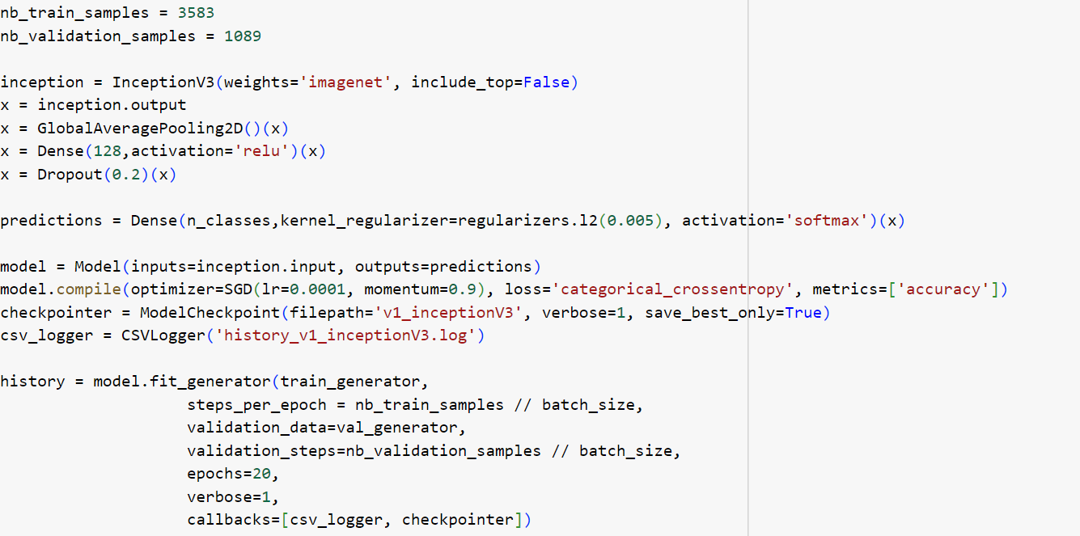
Image Preprocessing-II

Slide 24
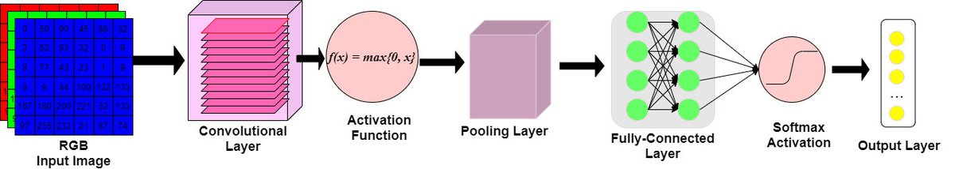
Model Building Overview
CNN
InceptionV3
Food Image Classification

Slide 25
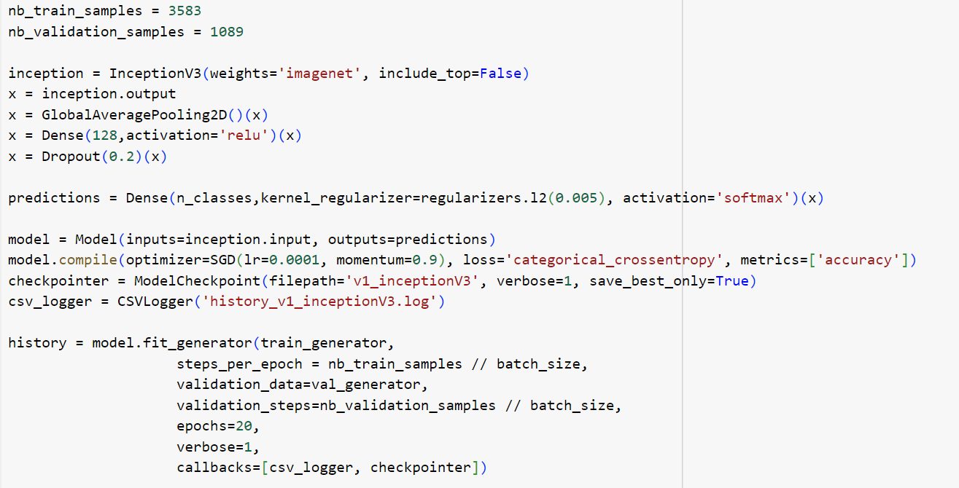
Model Building Overview

Slide 26
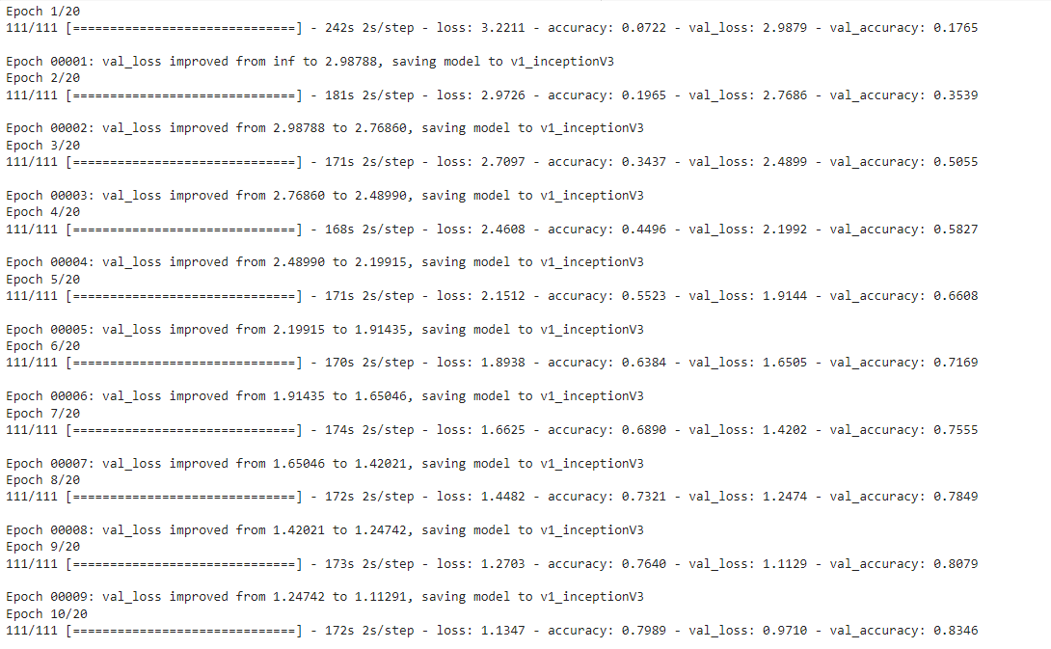
Model Building

Slide 27
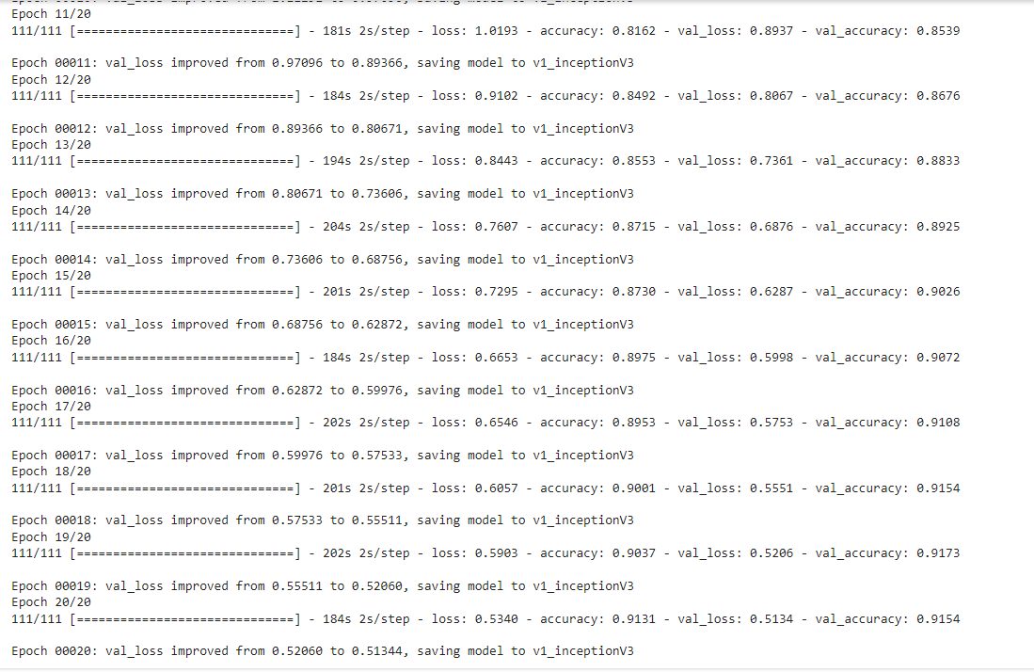
Model Building

Slide 28
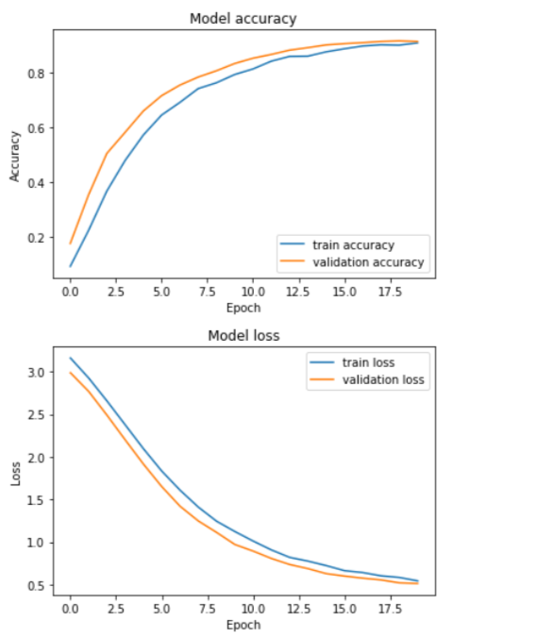
Accuracy and Loss curves

Slide 29
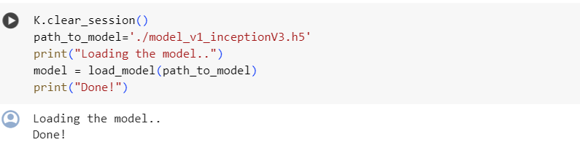
Model Loading

Slide 30
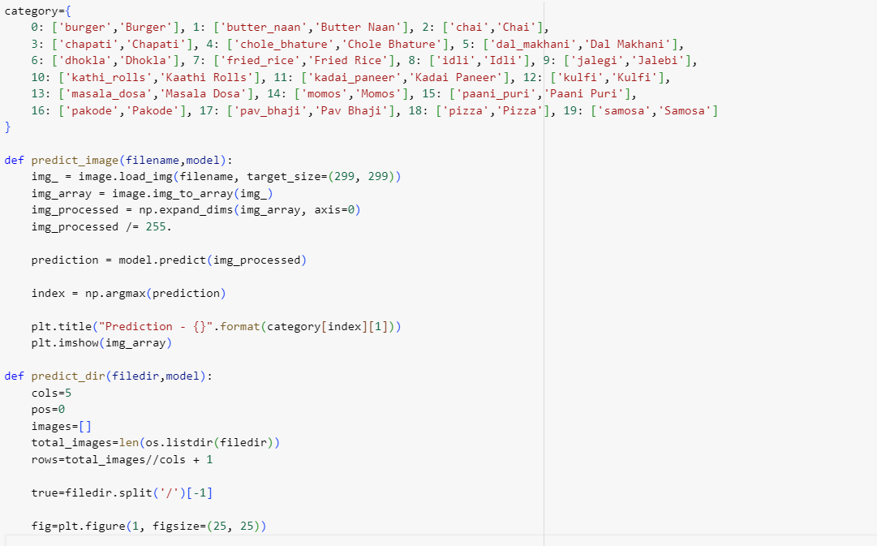
Model Testing (def)

Slide 31
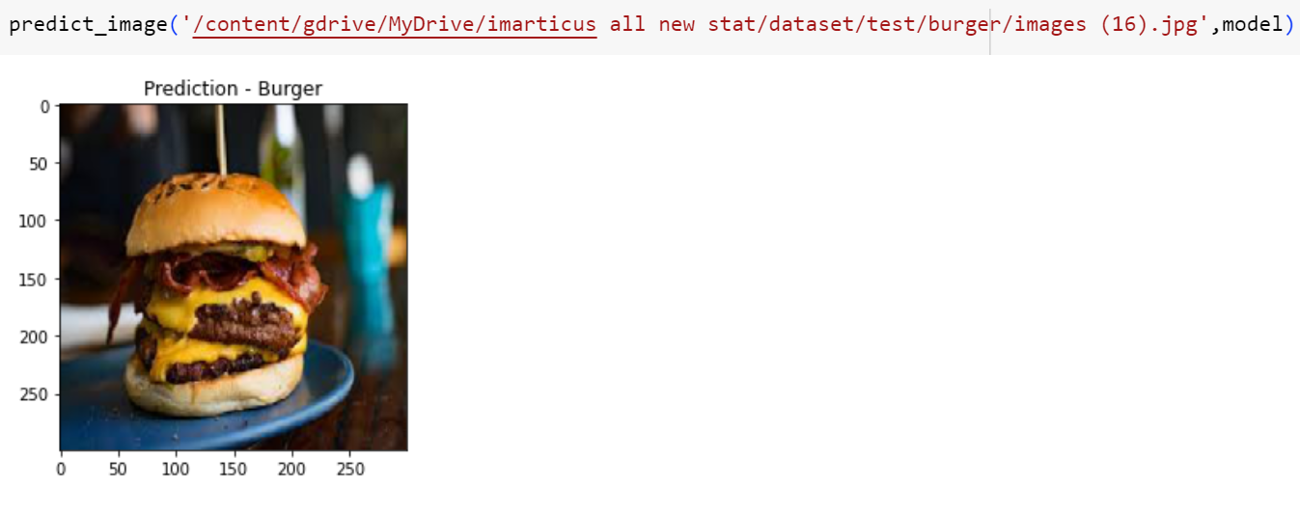
Single image prediction

Slide 32
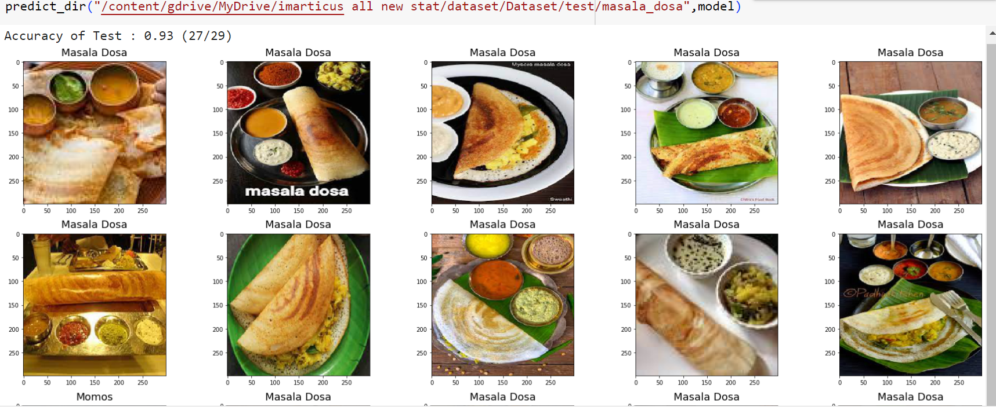
Predicting category-II

Slide 33
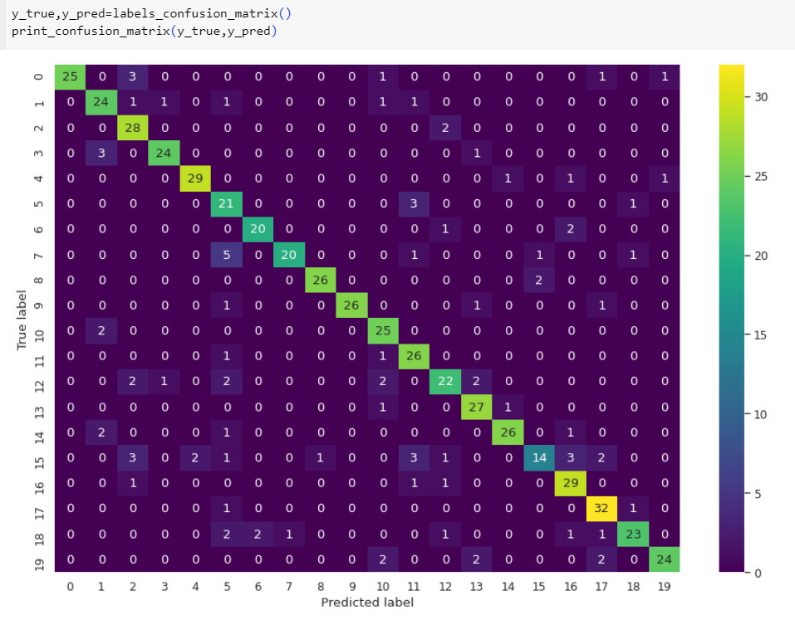
Confusion Matrix

Slide 34
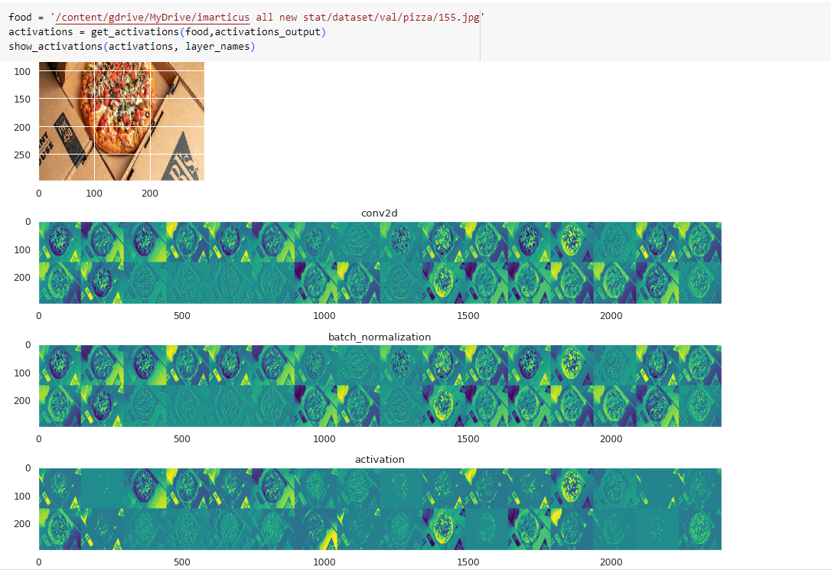
LAYER WISE ACTIVATIONS

Slide 35
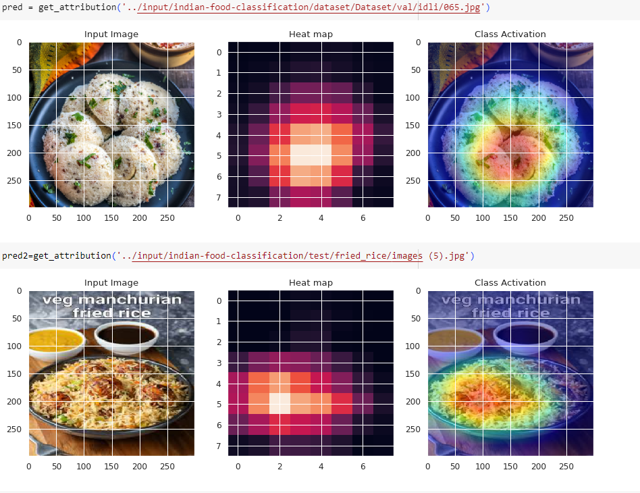
Generating Heatmaps

Slide 36
Future Scope
The future scope of our food image classification project for hotels is promising, with opportunities to enhance guest experiences and streamline operations. By expanding our dataset and integrating real-time detection capabilities, we aim to personalize menu recommendations, ensure food quality and safety, optimize inventory management, and create visually appealing marketing materials. Leveraging emerging technologies like advanced sensors and IoT devices, we can innovate in areas such as menu personalization, inventory management, and guest engagement.

Slide 37
Conclusion
In conclusion, our food image classification project is poised to revolutionize the way we approach food-related industries. By leveraging advanced technologies and expanding our dataset, we aim to enhance menu personalization, ensure food quality and safety, optimize inventory management, and create engaging marketing materials. Through collaborative efforts and user-friendly applications, we strive to elevate dining experiences while maximizing efficiency and customer satisfaction.

Slide 38
Thank You

